Slide 1
Broad topics
DNA replication (aspects covered after exam 1)
Methods for genetic engineering/genome modification/genome editing including CRISPR-Cas9
Methods for DNA sequencing
Methods for measuring gene expression
Telomeres and telomerase
DNA damage and repair
Homologous recombination
Transcription and RNA processing

Slide 2
Gene replacement with an antibiotic resistance marker: a common and reasonably efficient method for making gene knockouts in bacteria and yeast.
PCR product
hyg^{R}
M. smegmatis chromosome
…
rnase J
…
M. smegmatis chromosome
…
hyg^{R}
…

Slide 3
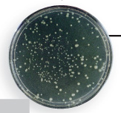
PCR
Transformation
Homologous recombination is naturally very efficient in budding yeast (Saccharomyces cerevisiae)
The gene replacement cassette is a linear piece of DNA usually made by PCR.
In many bacteria, a separate helper plasmid is needed to express exogenous recombinases and increase recombination efficiency.
Drug selection
Test the phenotype of the strain!

Slide 4
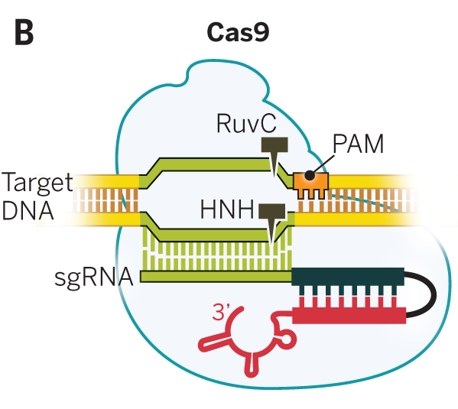
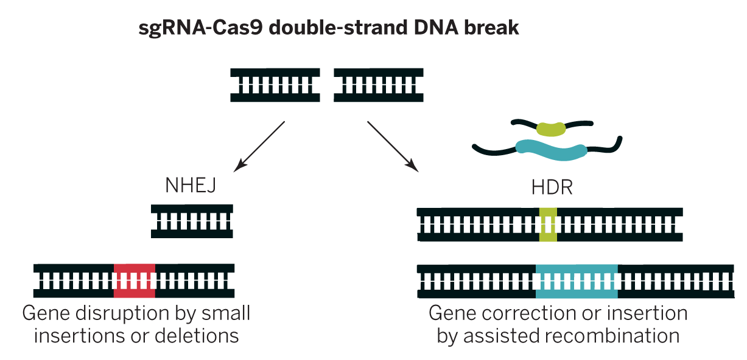
sgRNA-Cas9 together cause a double-strand break at a location specified by the sgRNA sequence and presence of a PAM
Note that the sgRNA is a single strand including the green, black, and red segments
Target DNA
Doudna and Charpentier. Science 2014;346:1258096
Notes:
Cas9 recognizes PAM, will not cleave targeted site in absence of that recognition.

Slide 5
Cas9-induced double-strand breaks can be repaired in two ways useful for genetic engineering
Doudna and Charpentier. Science 2014;346:1258096
Notes:
Why would you want to use the NHEJ method? The HDR method?

Slide 6
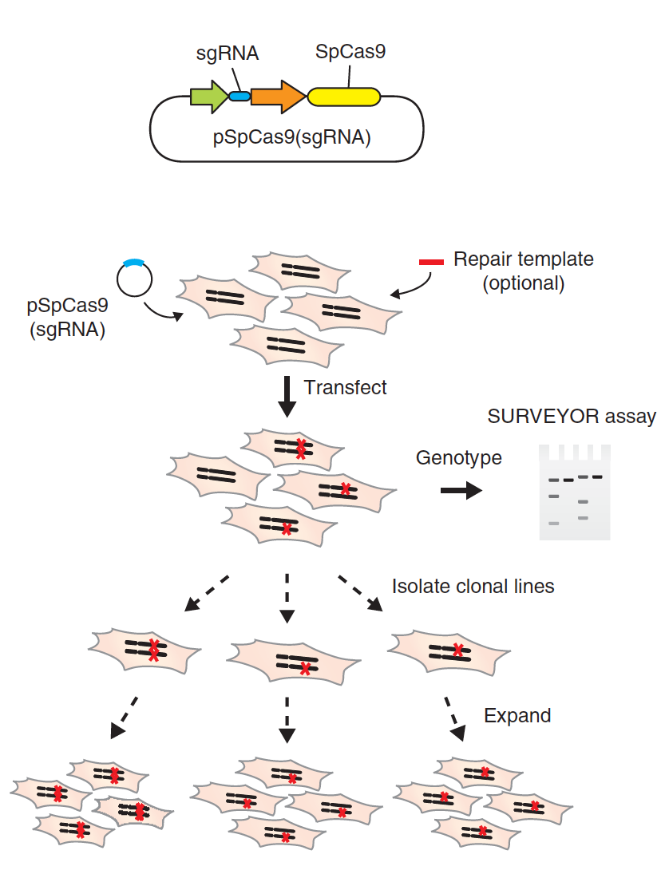
A basic CRISPR-Cas9 genome editing workflow
Design, make, and purify plasmid to express Cas9 and sgRNA
Repair template (optional – when would you use one?)
and genotype
Ran et al (2013). Nature Protocols, 8(11), 2281–2308. http://doi.org/10.1038/nprot.2013.143

Slide 7
Techniques for sequencing DNA
Why might you want to perform DNA sequencing? Think of hypothetical scenarios.
Why would you choose Sanger sequencing vs a next-generation sequencing technique such as Illumina?

Slide 8
Sanger sequencing
Appropriate and cost-effective for sequencing small numbers of DNAs at a time (eg, a single gene, a few genes, or a cloning product).
Like a one-sided PCR that uses a single primer and a mix of dNTPs and fluorescently labeled ddNTPs.
End up with a mix of ssDNA molecules of various lengths each with a labeled ddNTP at the 3’ end.
Use capillary gel electrophoresis to determine the base at the 3’ end of each uniquely sized product molecule.

Slide 9
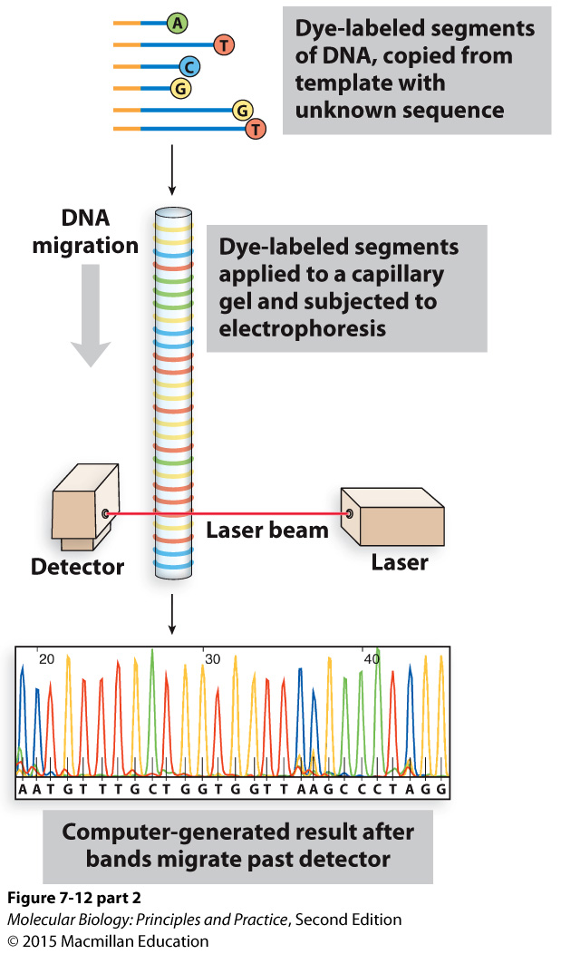
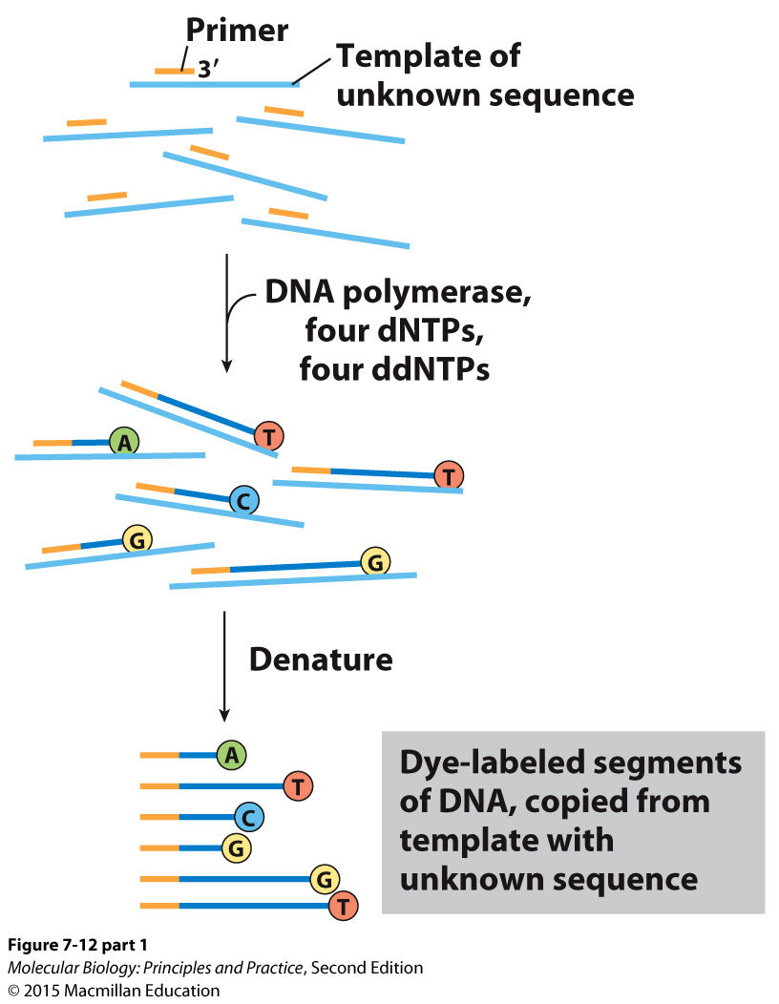
Sanger sequencing

Slide 10
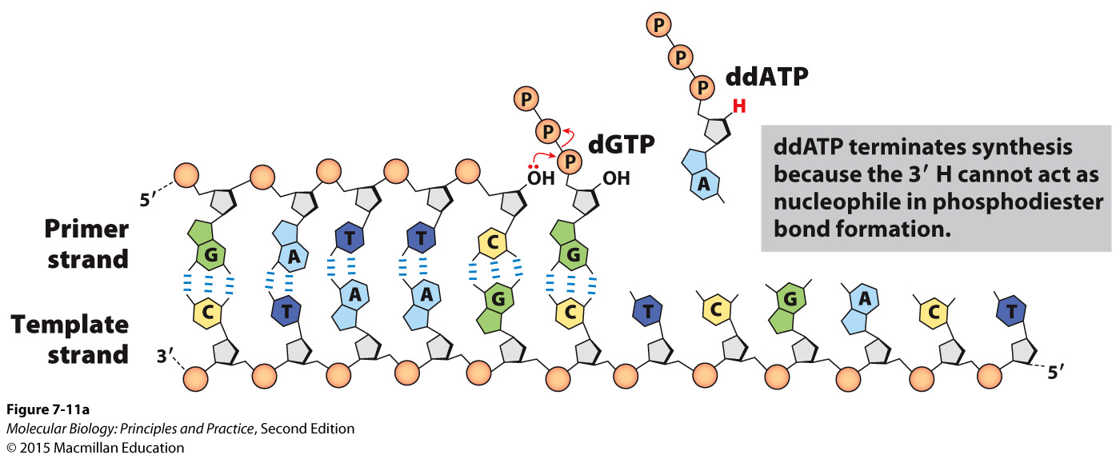
Sanger sequencing

Slide 11
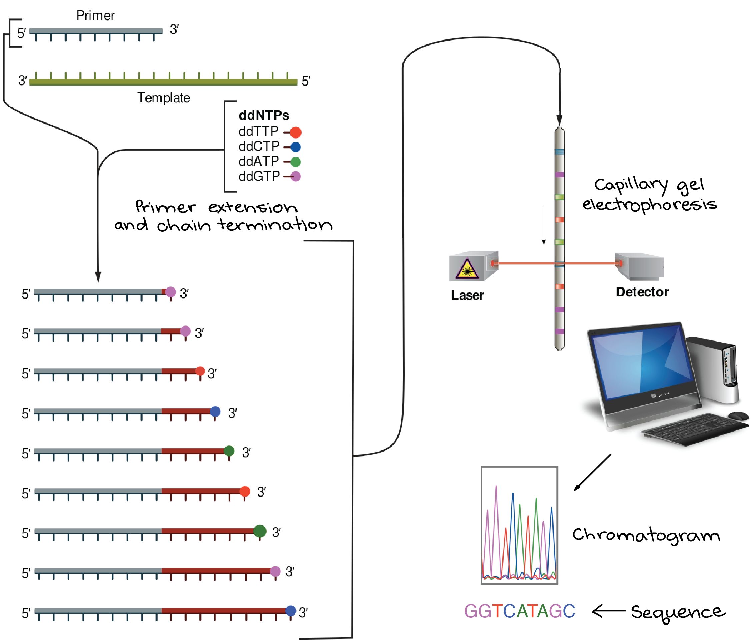
Sanger sequencing
Graphic: https://www.khanacademy.org/science/biology/biotech-dna-technology/dna-sequencing-pcr-electrophoresis/a/dna-sequencing

Slide 12
Illumina sequencing
A type of next-generation sequencing, appropriate and cost-effective for sequencing thousands or millions of DNAs at a time (eg, whole genomes).
Molecules of interest must be made into a library in which they are flanked by common adapter sequences.
Library molecules anneal to primers stuck to the surface of a flow cell, and in situ PCR is used to turn each molecule into a cluster of identical molecules.
Sequencing is carried out by multiple cycles in which fluorescently labeled dNTPs with blocked 3’ ends are added, incorporated by DNA polymerase, imaged, and chemically treated to remove the label and 3’ block.
Each cluster produces a read (a series of nts in order). The reads can be aligned to a reference genome to identify positions where the sample and the reference differ, or the reads can be aligned to each other to determine the sequence de novo.

Slide 13
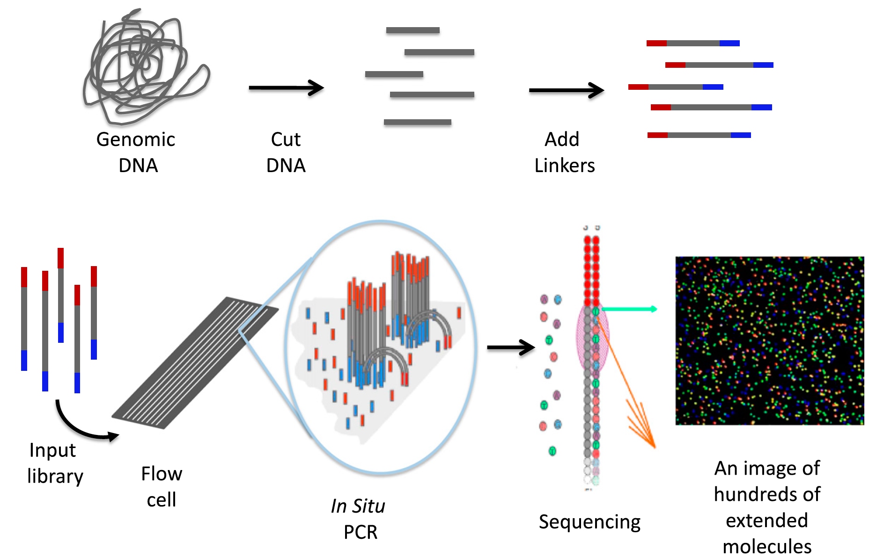
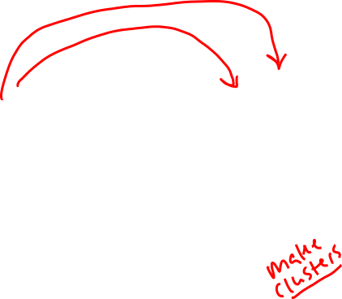
Illumina sequencing
Shear DNA
Add adapters
Library
Each cluster (dot) reports the sequence of a different molecule
Johnsen J M et al. Blood 2013;122:3268-3275

Slide 14
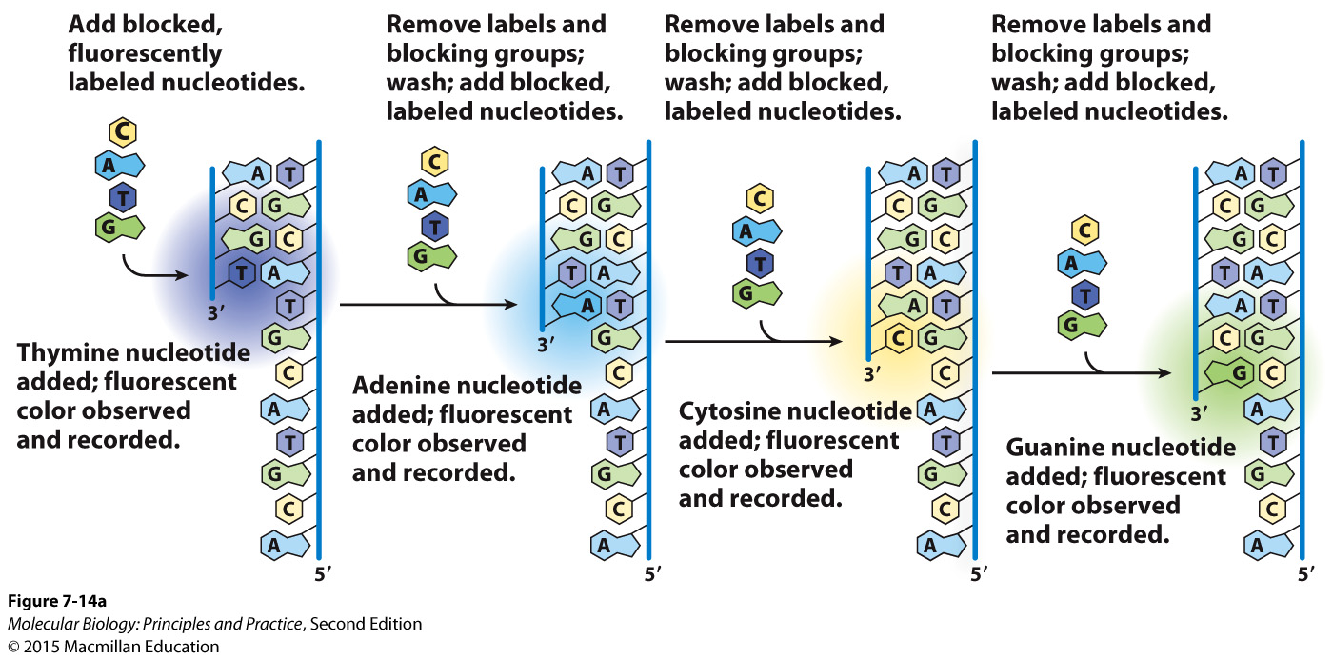
Illumina sequencing

Slide 15
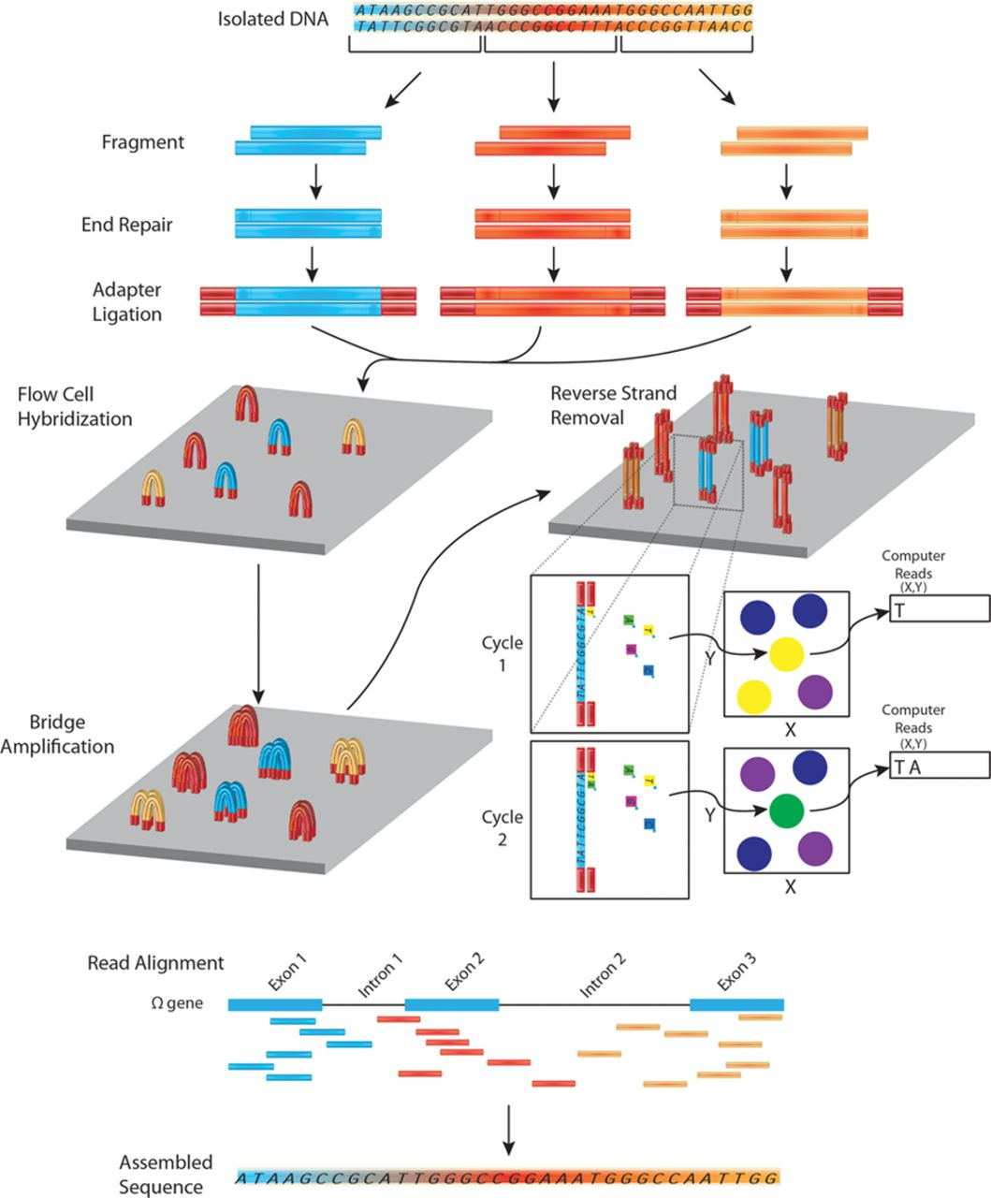

Overview of DNA sequencing using the Illumina platform.
Jared M. Churko et al. Circ Res. 2013;112:1613-1623
Copyright © American Heart Association, Inc. All rights reserved.
Notes:
Overview of DNA sequencing using the Illumina platform. In next-generation DNA sequencing, DNA is first fragmented into smaller input-sized fragments by enzymes or by sonication. The ends of these fragments are repaired and specific adapters are ligated to the ends of the fragments, allowing hybridization to a flow cell to occur. A bridge amplification step is performed to create a cluster of fragments with the same sequence. One strand of DNA is removed and fluorescently labeled nucleotides are passed by each cluster. An image of the flow cell is recorded for the first cycle and a computer processes which nucleotide was incorporated at each cluster’s co-ordinates. The fluorescent label is cleaved and a second round of fluorescently labeled nucleotides is passed by each cluster. Again (cycle 2) the nucleotide is recorded and each cycle leads to the sequence of each fragment (a read). These reads are then aligned to a reference genome. By assembling reads (merging short reads together), it is therefore, possible to reconstruct the unfragmented original sequence.

Slide 16
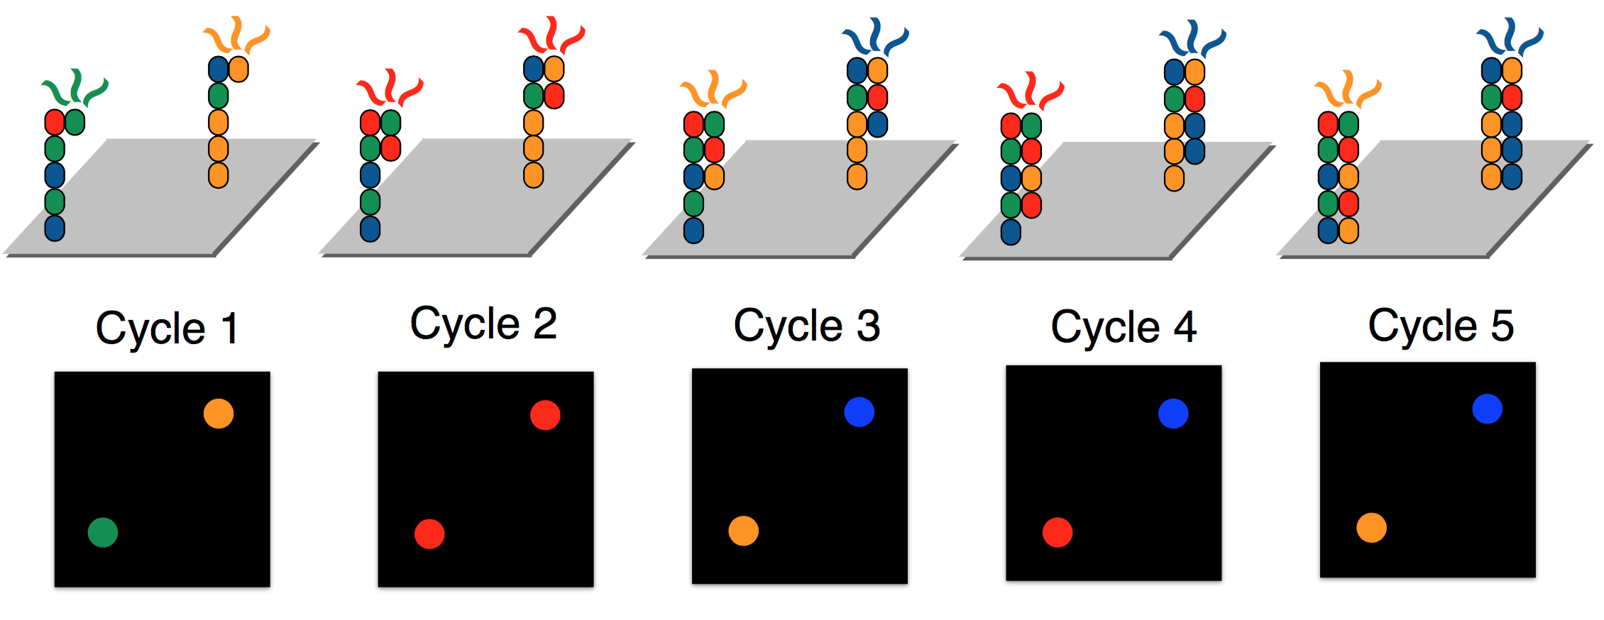
A cluster on an Illumina flow cell emits a different colored light depending on the identity of the most recently incorported nt
The sequence of consecutive nts recorded for an individual cluster are a read
Graphic: http://data-science-sequencing.github.io/lectures/lecture2/

Slide 17
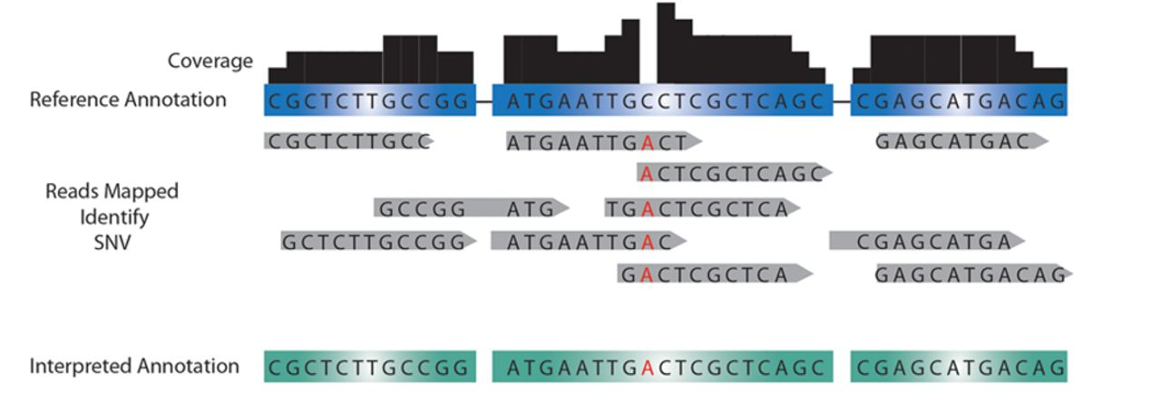
Detection of single-nucleotide variants
Jared M. Churko et al. Circ Res. 2013;112:1613-1623
Copyright © American Heart Association, Inc. All rights reserved.
Notes:
Detection of single-nucleotide variants (SNVs) and copy number variants (CNVs). Mapping HTS reads to control annotations (unaffected family member, reference annotation) is used to identify single-nucleotide changes up to large structural DNA changes. Discrepancies between the reference annotation and the mapped sequence can be called to annotate SNV. More reads mapped (ie, higher read depth) results in a higher confidence level to the called SNV in question. If a disproportionate amount of reads are mapped to a gene for a given read depth, this region of DNA may be interpreted as a CNV.

Slide 18
Sequencing a new/unknown genome
Instead of aligning reads to a reference sequence, reads are aligned to each other. With enough overlapping reads, the sequence of most of the genome can be pieces together.

Slide 19
Techniques for measuring gene expression
Why might you want to measure gene expression? Think of a hypothetical experiment.
Why would you choose quantitative PCR, microarrays, or RNAseq?

Slide 20
Quantitative PCR
To use for measuring gene expression, RNA is converted to cDNA by reverse transcription, then cDNA is used as template in PCR.
Quantitative PCR uses fluorescent dyes or probes and a special instrument to measure the amount of product present after each cycle.
In early cycles, the amount of product doubles after each cycle and is thus proportional to the amount of starting material.
The cycle at which the amount of product crosses a threshold is called the ct. By comparing the ct obtained from different genes or samples, the relative abundance of each gene can be determined.
Appropriate and cost-effective for measuring the expression of a small number of genes.
Large dynamic range.

Slide 21
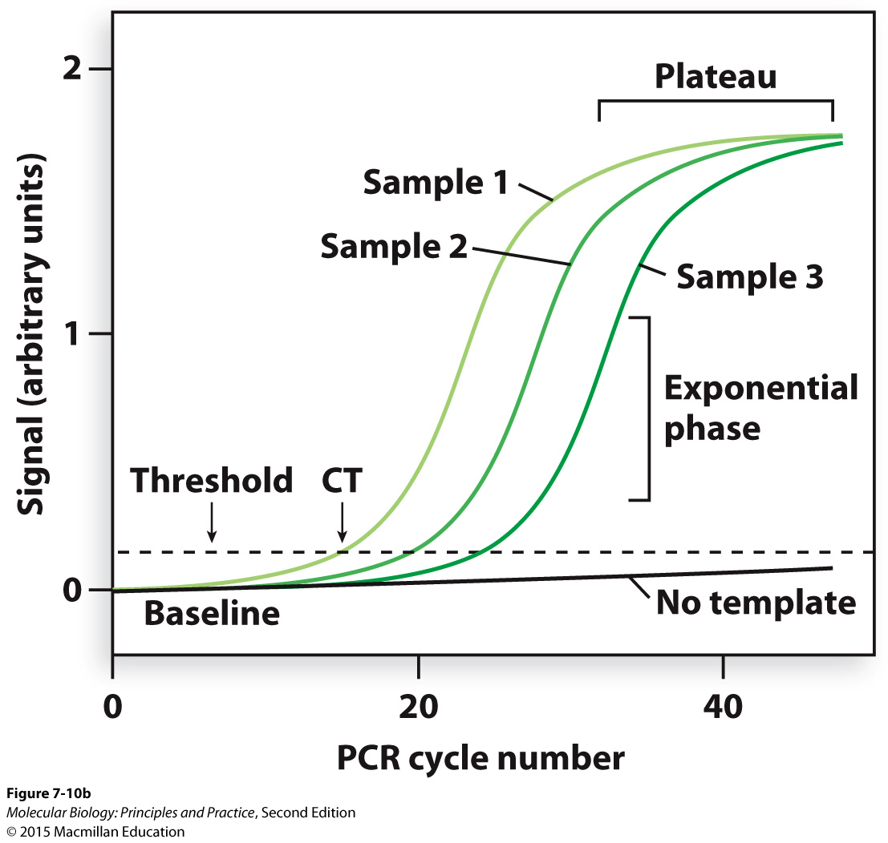
Amplification is exponential only in the early cycles of PCR

Slide 22
Microarrays
RNA is converted to cDNA by reverse transcription using fluorescently labeled dNTPs, then cDNA is allowed to hybridize to complementary oligonucleotides spotted on the surface of a glass slide.
If two samples are labeled with different colors then mixed and applied to the same array, the relative abundance of each RNA in each sample can be determined by comparing the amount of each color at each spot.
Appropriate and cost-effective for measuring the expression of thousands of genes at a time.
Limited dynamic range.

Slide 23
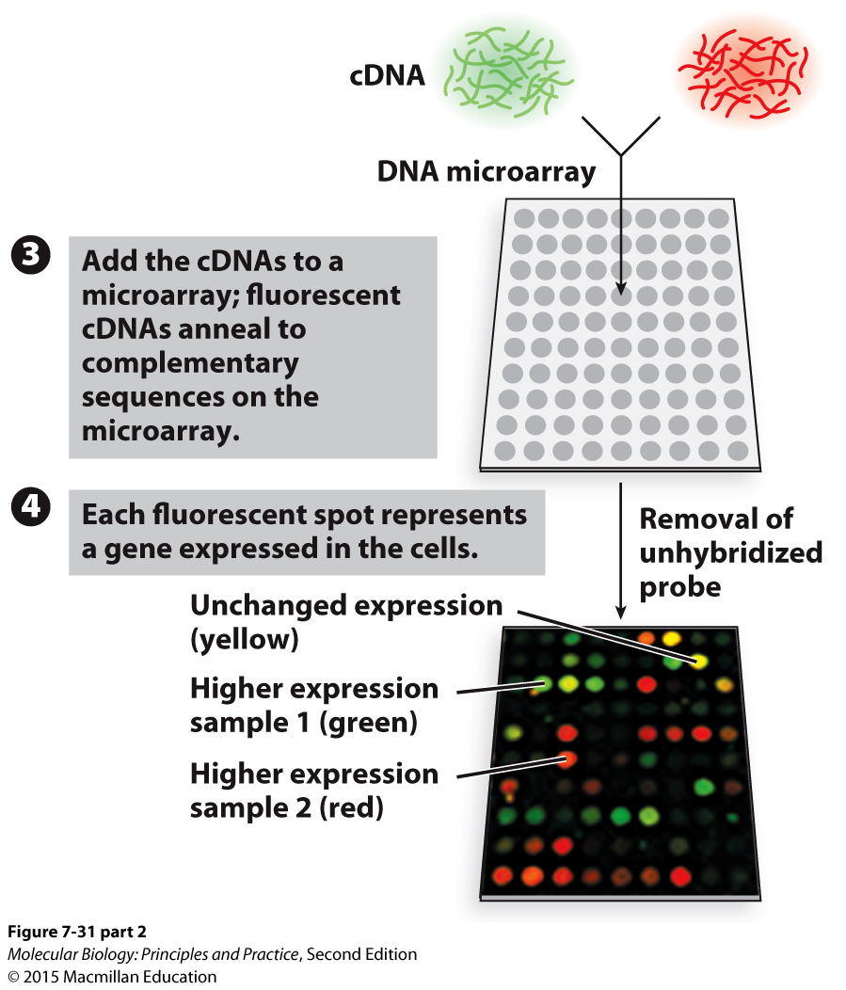
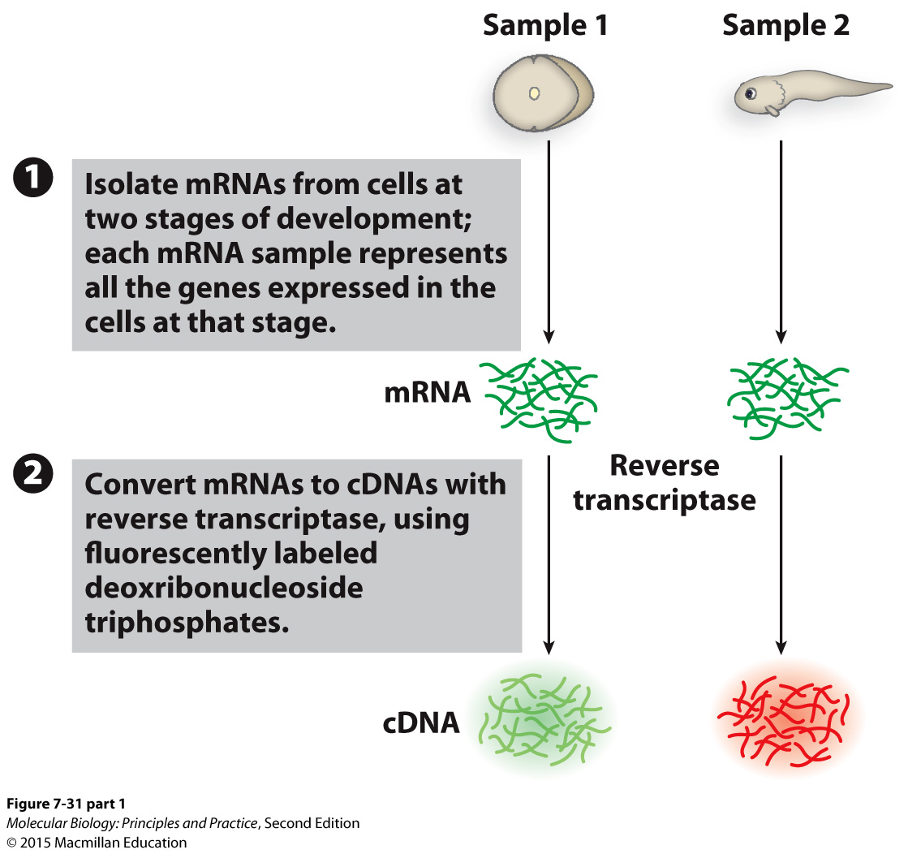
Microarrays

Slide 24
RNA-seq
Like regular Illumina sequencing, but:
Starting material is RNA converted to cDNA before constructing the library.
Analyze data differently: align reads to a reference genome, then count the number of reads aligning to each gene or region of interest.
Allows analysis of expression without any assumptions of which regions of the genome will be expressed.
Appropriate and cost-effective for measuring the expression of thousands of genes at a time.
Large dynamic range.

Slide 25
RNA-seq
Shear and reverse transcribe
RNA
cDNA
Library
Johnsen J M et al. Blood 2013;122:3268-3275

Slide 26
RNA-seq
Number of reads at each position
Quantification: count and compare reads aligning to each gene or region of interest.

Slide 27
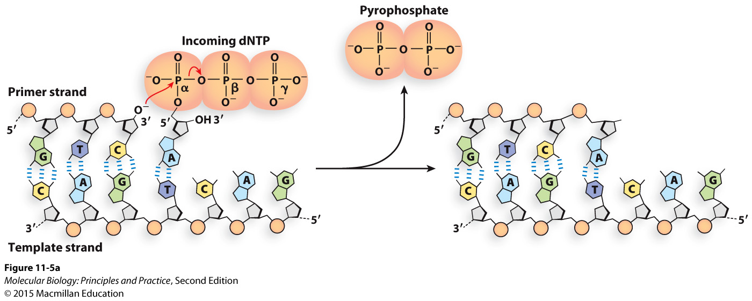
The chemistry of DNA polymerization
Nucleophilic attack on P in phosphate by deprotonated O in hydroxyl.
Replacing one high-energy bond with another is energetically close to neutral.
Formation of hydrogen bonds and base stacking interactions make DNA polymerization energetically favorable.
Much of the energy needed for DNA polymerization therefore goes into synthesis of the dNTPs.
Notes:
What kind of reaction is this? Which atom is the nucleophile?

Slide 28
Many DNA polymerases have exonuclease activity
Pol III: 3’ to 5’ exonuclease activity is used for proofreading
Pol I: 5’ to 3’ exonuclease activity is used for degrading primers, 3’ to 5’ exonuclease activity is used for proofreading
Exonuclease activities are contained in separate domains or active sites (it’s not a reversal of the polymerization reaction)

Slide 29
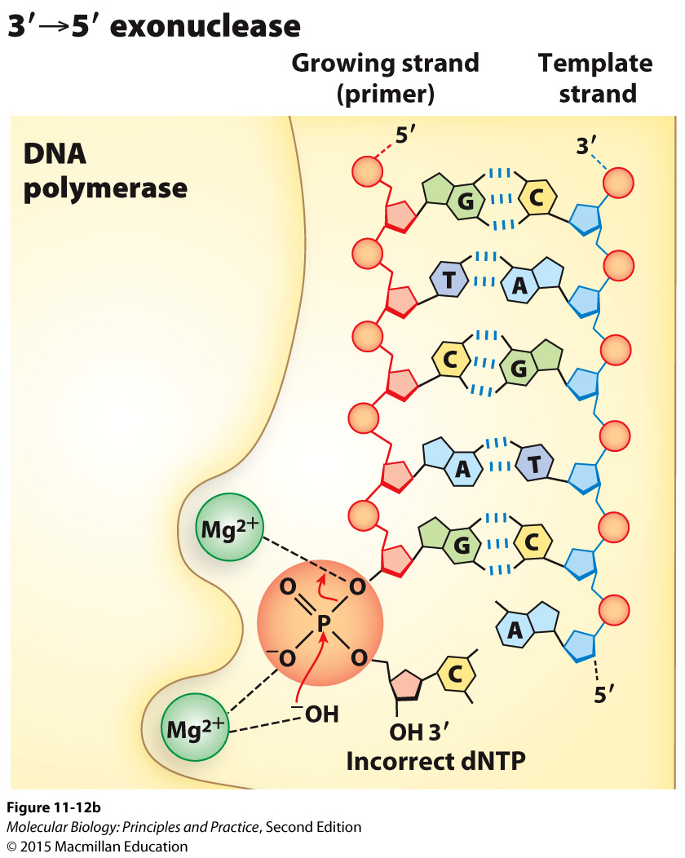
The chemistry of 3’ to 5’ exonuclease activity
(recall: phosphodiester bonds are made and broken by nucleophilic attacks on phosphorus atoms in phosphates)

Slide 30
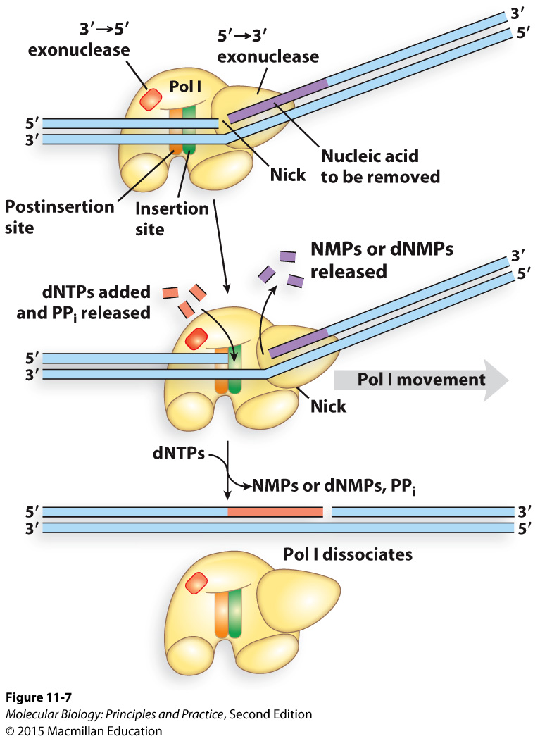
Pol I uses 5’ to 3’ exonuclease activity to remove RNA primers and then replaces them with DNA

Slide 31
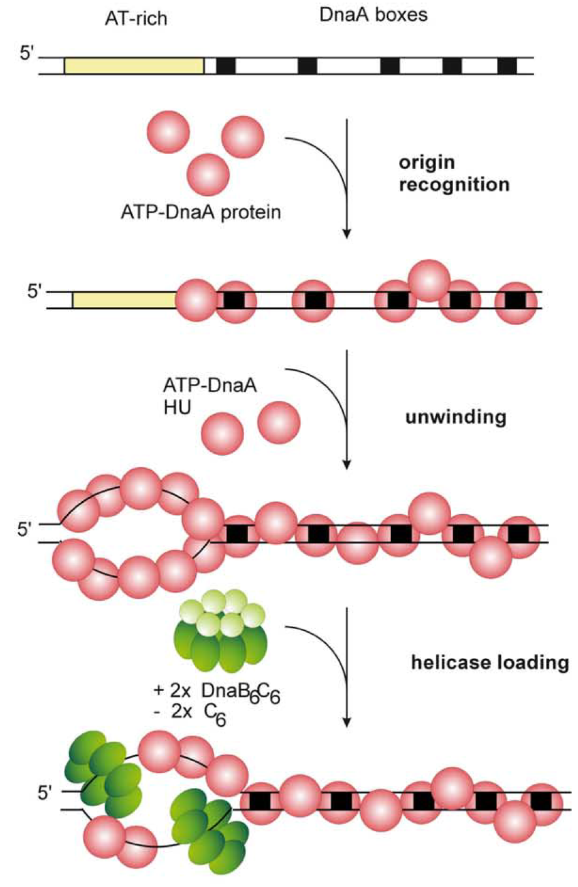
Initiation of DNA replication
DnaA is the initiator in bacteria.
In eukaryotes, the origin recognition complex (ORC) performs an analogous function.
The expression, binding, and activity of DnaA and ORC are highly regulated.
Messer, W. (2002) FEMS Microbiology Reviews, 26(4), 355–374.

Slide 32
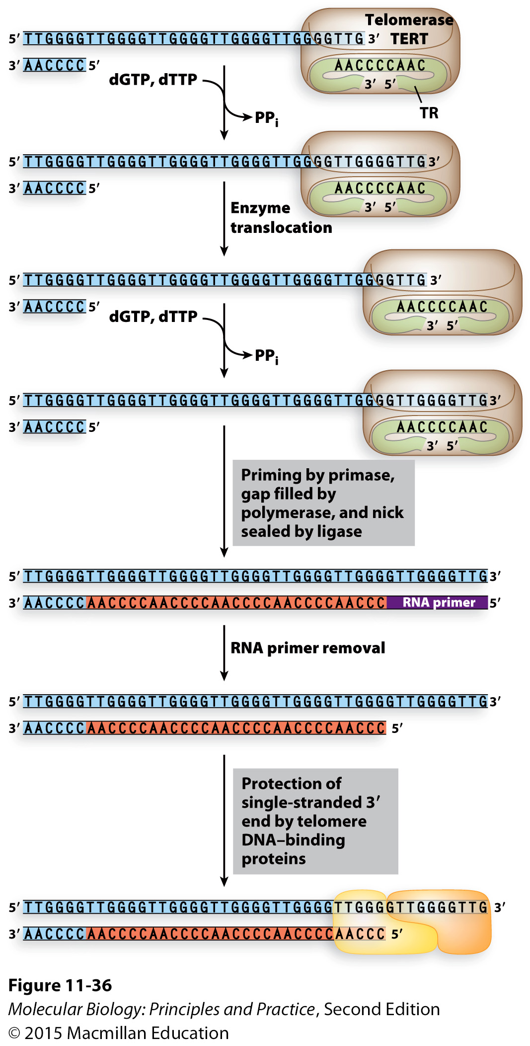
Telomerase uses an RNA template to extend the ends of chromosomes
What is a telomere?
Why do chromosome ends shorten during replication?
In which cells types is chromosome shortening a problem?
What is telomerase composed of?
How does telomerase prevent telomere shortening?
Why do most cancer cells express telomerase?

Slide 33
Types and sources of DNA damage Be prepared to explain where it comes from and the consequences if unrepaired (effects on replication, mutations that might ensue)
Base misincorporations
Polymerase slippage
Thymine dimers
Spontaneous hydrolysis examples:
Cytosine deamination
Loss of base/formation of abasic site
Other types of damage: if given an example and told its propensity for mis-pairing, be able to state the mutation that will result
Strand breaks

Slide 34
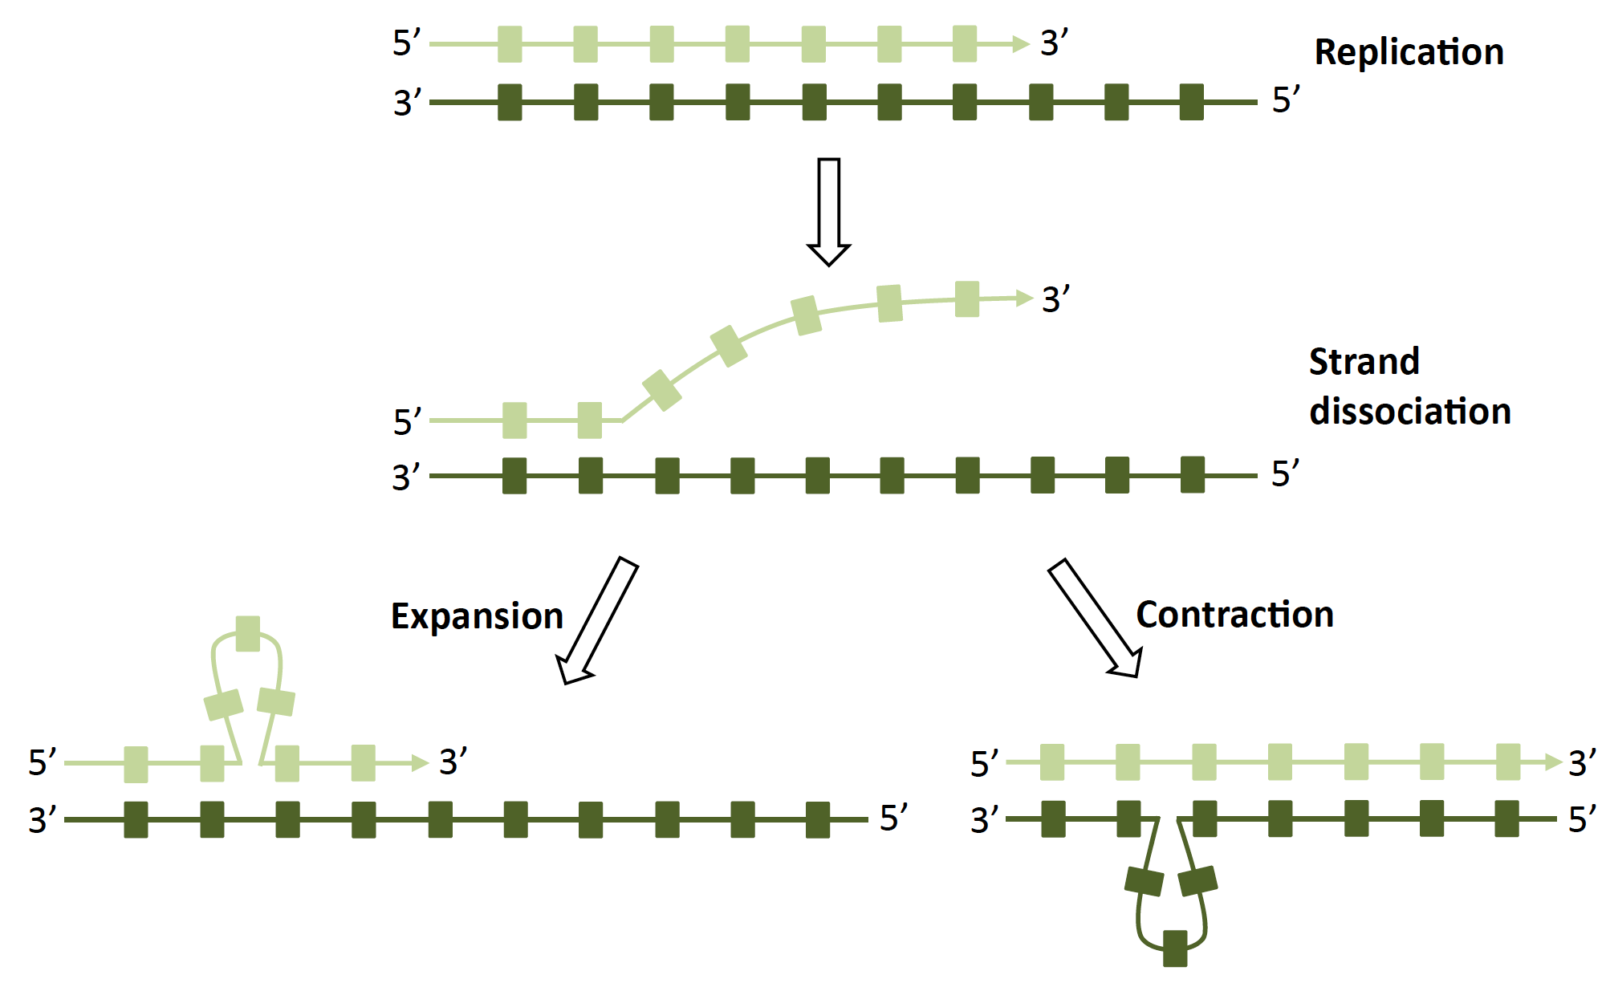
Polymerase slippage -> indels
Occurs most frequently at mononucleotide repeats and trinucleotide repeats
Top strand has insertion
Top strand has deletion

Slide 35
Damage that leads to base misincorporations by normal replicative polymerases
Cytosine deamination
Replication
AAGUGT
TTCACA
AAGTGT
TTCACA
AAGCGT
TTCGCA
AAGUGT
TTCGCA
Replication
C->T mutation
(G->A mutation)
AAGCGT
TTCGCA
Replication
AAGCGT
TTCGCA
Guanine oxidation
AAGCGT
TTCGCA
AAGCGT
TTCGCA
Replication
AAGAGT
TTCTCA
AAGAGT
TTCGCA
8-oxo
C->A mutation
(G->T mutation)
8-oxo

Slide 36
Damage that leads to replication fork stalling, followed by translesion synthesis (TLS) polymerase bypass or cell death
Loss of base
(abasic site)
Replication
AAG-GT
TTCNCA
(N=base incorporated by error-prone TLS polymerase)
AAGCGT
TTCGCA
AAG-GT
TTCGCA
AAGCGT
TTCGCA
Replication
AAGCGT
TTCGCA
UV
AAGCGT
TTCGCA
AAGCGT
TTCGCA
Replication
NNGAGT
NNCTCA
NNGAGT
TTCGCA
(N=base incorporated by error-prone TLS polymerase)

Slide 37
Pathways for repairing or tolerating DNA damage
Translesion synthesis polymerases (what they are, how they work, consequences for the cell)
High-fidelity repair of damaged, mispaired, or missing bases:
Base excision repair
Nucleotide excision repair
Mismatch repair
Repair of double strand breaks:
Homologous recombination (high fidelity, all organisms, requires replicated chromosome or access to homologous chromosome)
Non-homologous end joining (low-fidelity, primarily eukaryotes)

Slide 38
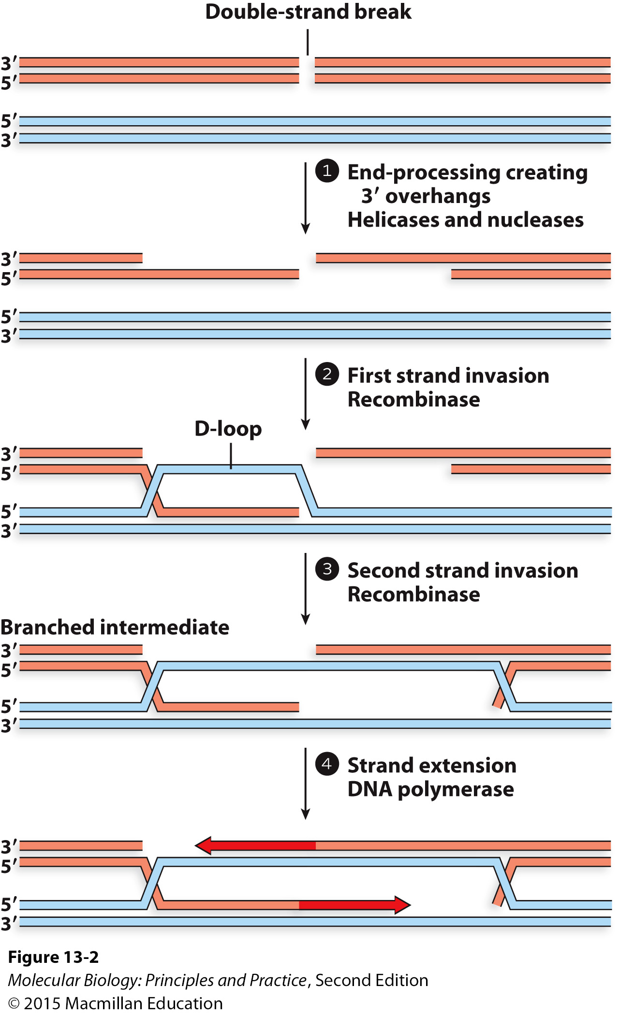
Homologous recombination
Be prepared to describe what is happening at each step if given an unlabeled figure, or what will happen next if given part of a figure.

Slide 39
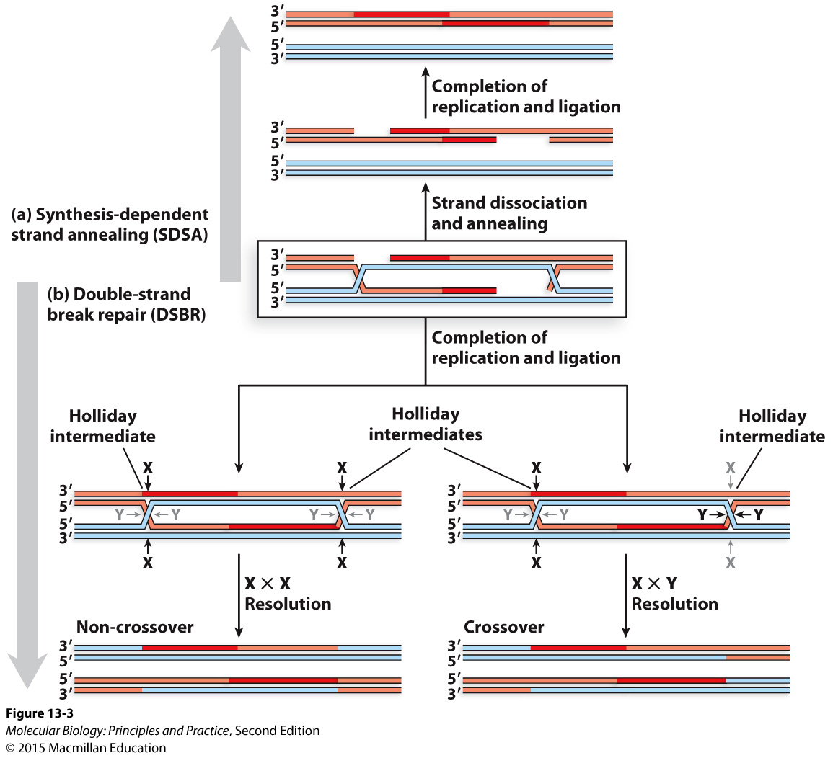
Homologous recombination
Be prepared to describe what is happening at each step if given an unlabeled figure, or what will happen next if given part of a figure.
Know the roles of recombinases RecA and RAD51, and Holliday junction resolvases.

Slide 40
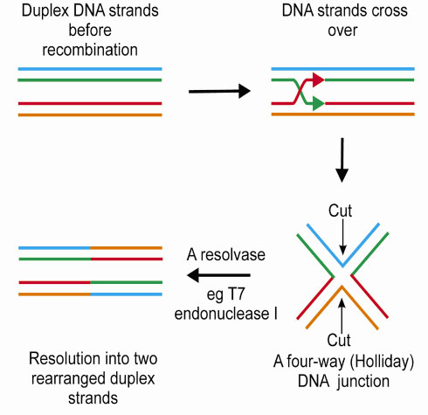
Resolution of a single Holliday junction
Graphic: http://www.esrf.eu/UsersAndScience/Publications/Highlights/2001/life-sciences/LS7.html

Slide 41
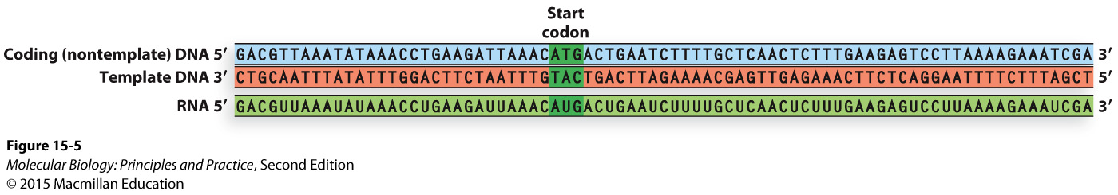
Transcription: the relationship between the coding strand, the template strand, and the RNA sequence

Slide 42
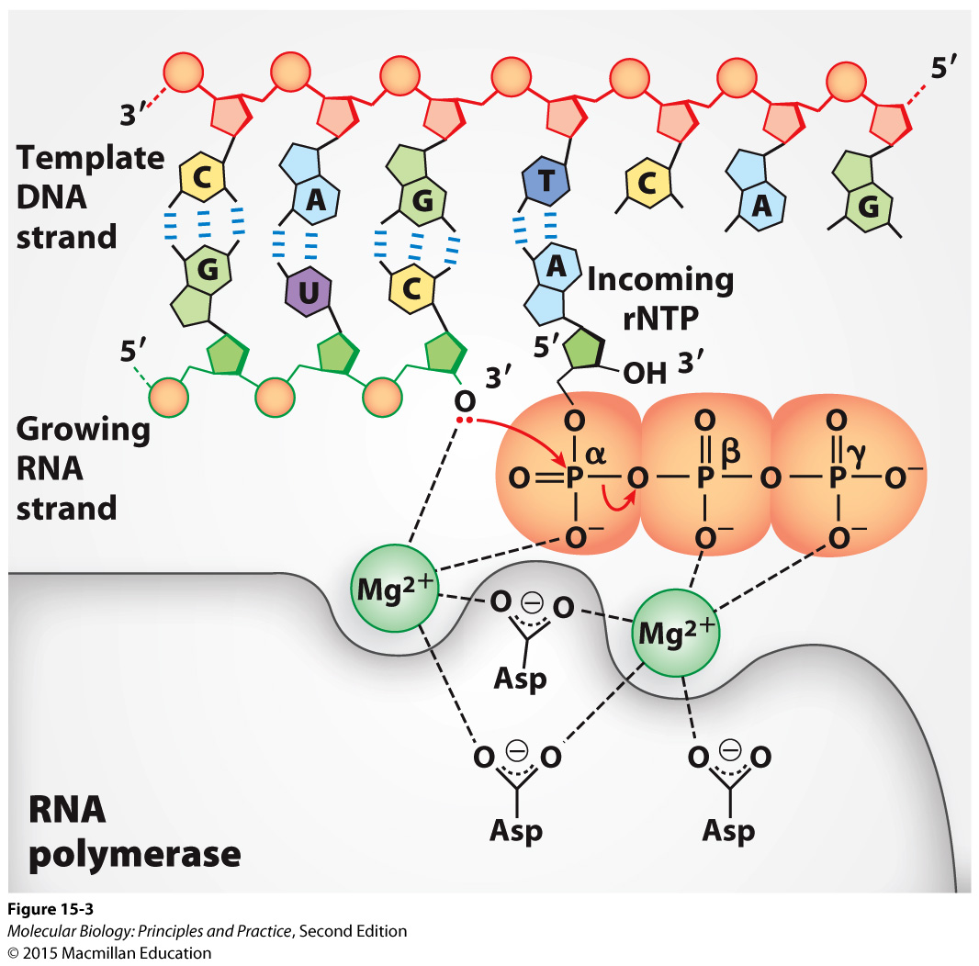
The chemistry of RNA polymerase activity

Slide 43
Some key aspects of transcription
Bacteria has one RNA Pol, eukaryotes have three – know names and functions
RNA polymerases have little or no proofreading activity.
Bacterial RNA pol requires a sigma factor to recognize, bind, and melt promoters and initiate transcription. Eukaryotic RNA Pol II requires general TFs (TBP and others).
Core promoters are bound by sigma/general TFs plus RNA pol.
Upstream promoter regions and enhancers are bound by other TFs that can enhance, repress, and conditionally regulate transcription.
Sigma and most general TFs are not needed for elongation and termination.
Promoter sequences, the proteins required to initiate transcription, and mechanisms of termination are completely different in bacteria and eukaryotes, and mostly different between the three eukaryotic RNA polymerases.
A bent arrow denotes the transcription start site (TSS).
The positions of promoter elements are denoted by negative numbers counting backwards from the TSS.

Slide 44
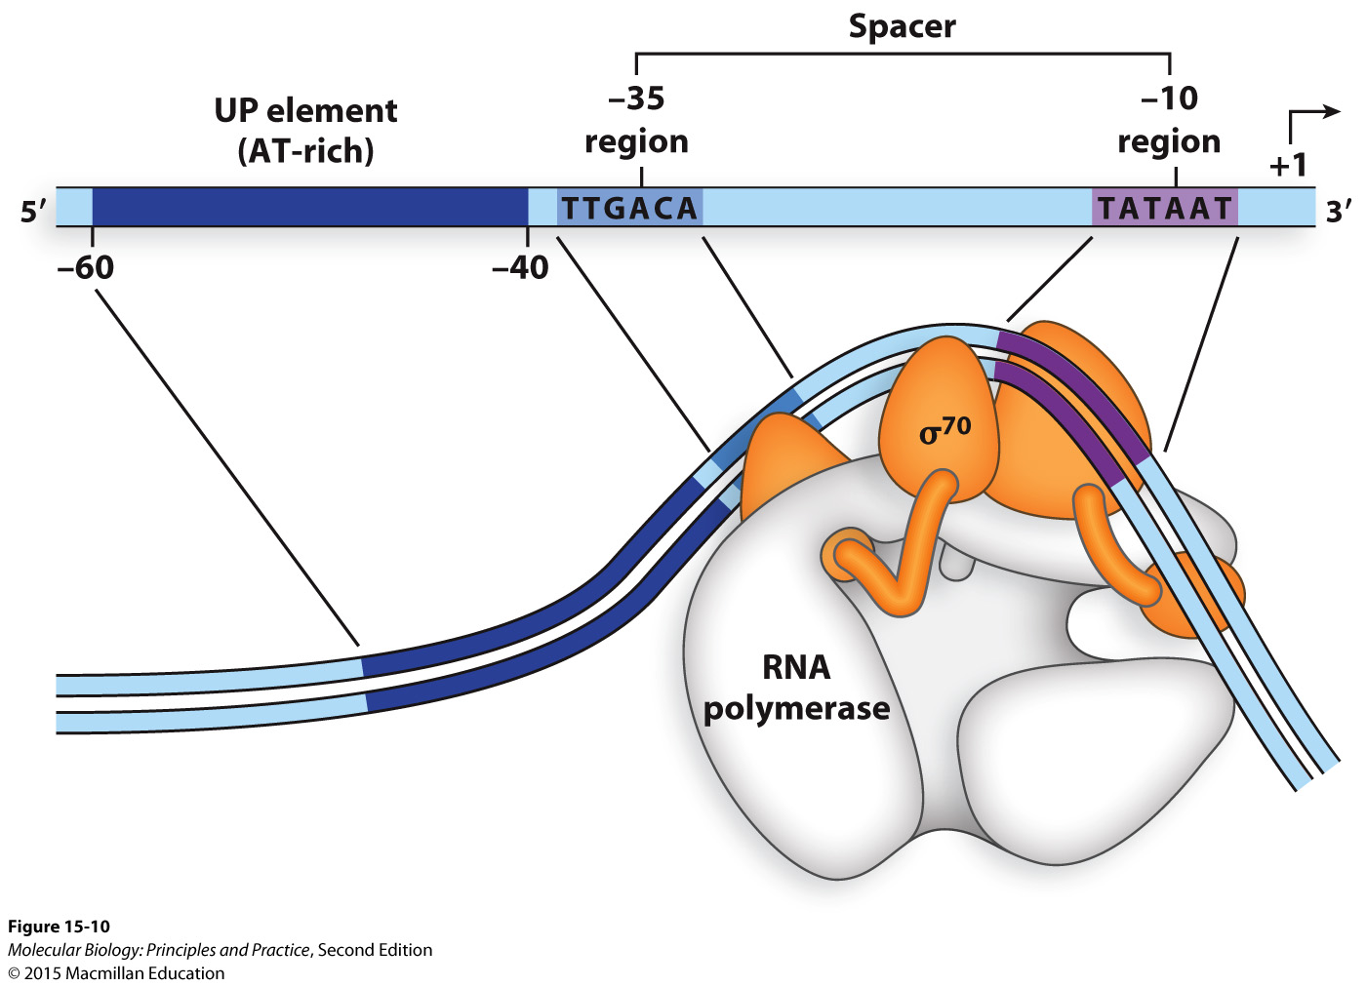
Bacterial promoters are recognized by sigma factors

Slide 45
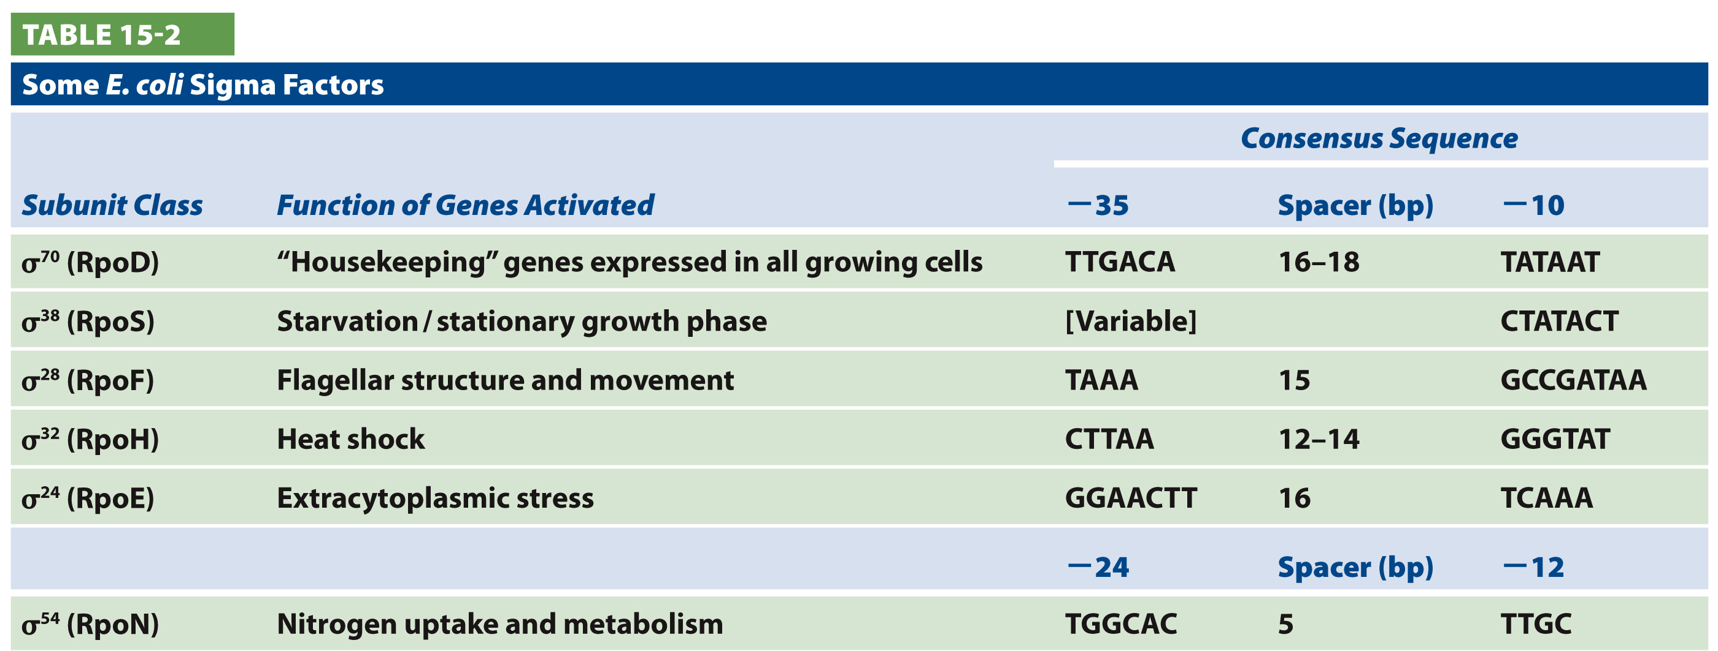
Bacteria: Alternative sigma factors associate with RNA polymerase core to induce expression of stress-response genes

Slide 46
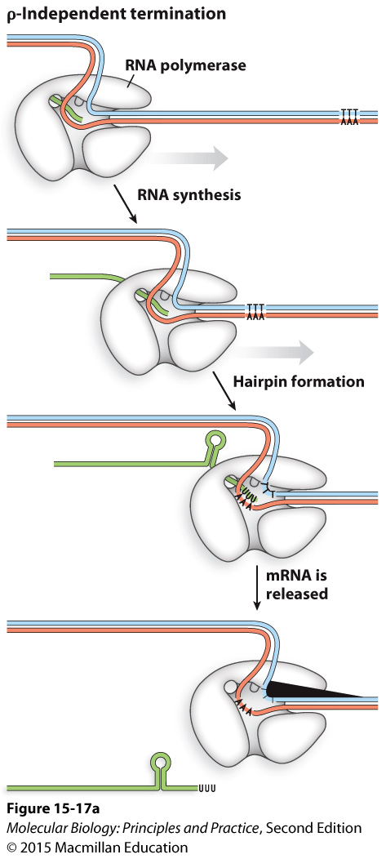
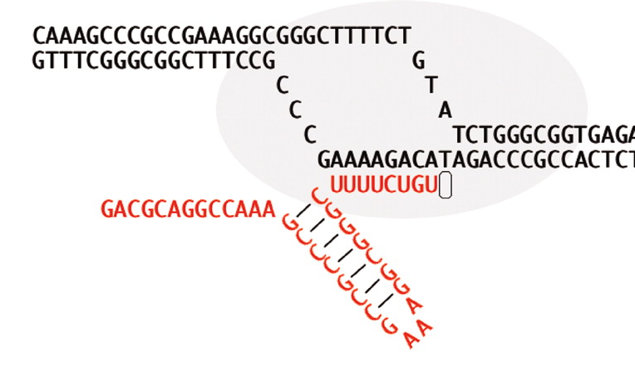
Bacteria: Rho-independent termination (caused by intrinsic terminators)
An intrinsic terminator consists of a hairpin followed by a U-rich region.
Park and Roberts, doi: 10.1073/pnas.0600145103

Slide 47
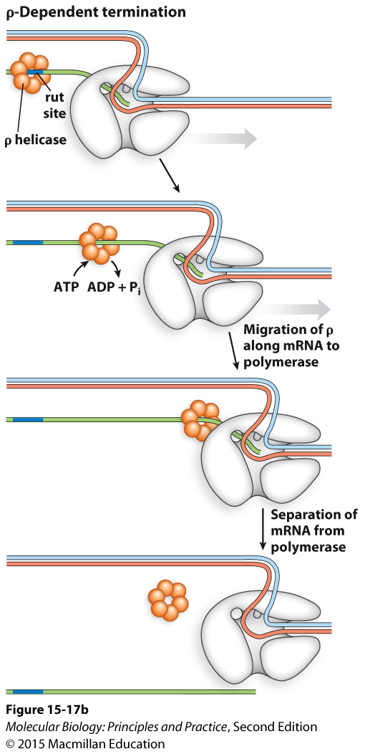
Bacteria: Rho-dependent termination
Rho recognition sites are difficult to identify by sequence-gazing alone.

Slide 48
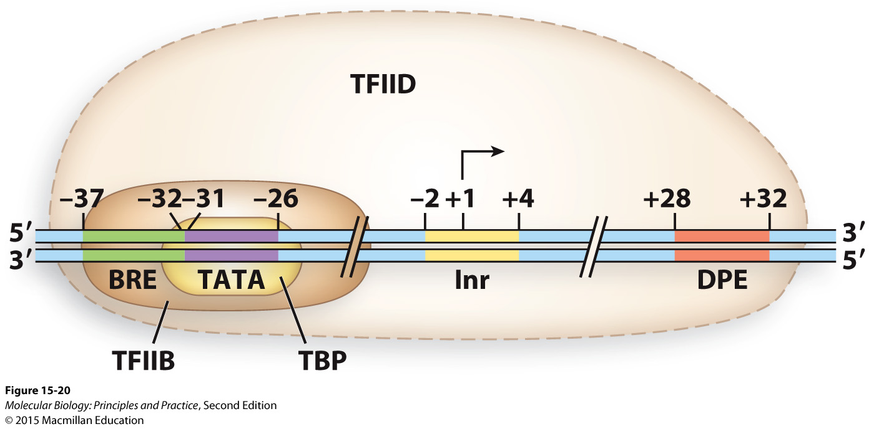
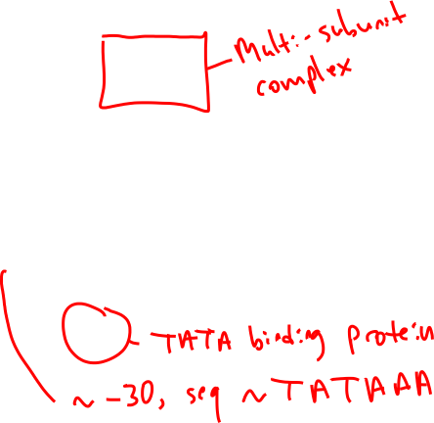
Eukaryotes: RNA Pol II core promoter bound by some general TFs

Slide 49
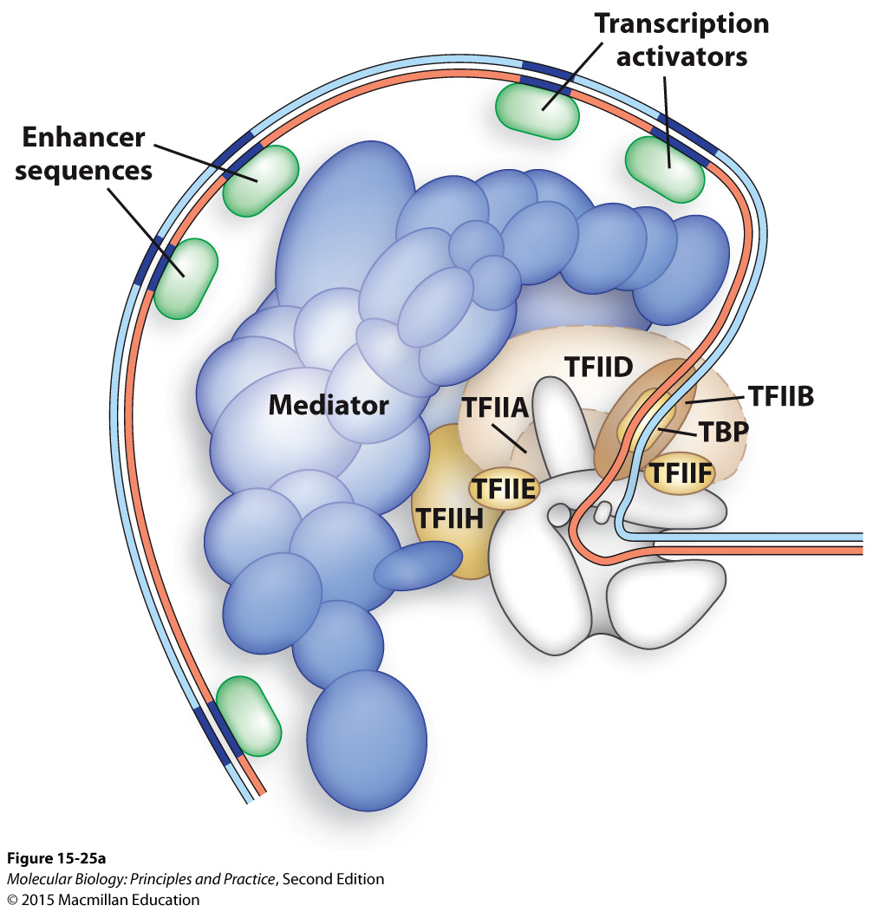
The mediator complex bridges upstream TFs to general TFs

Slide 50
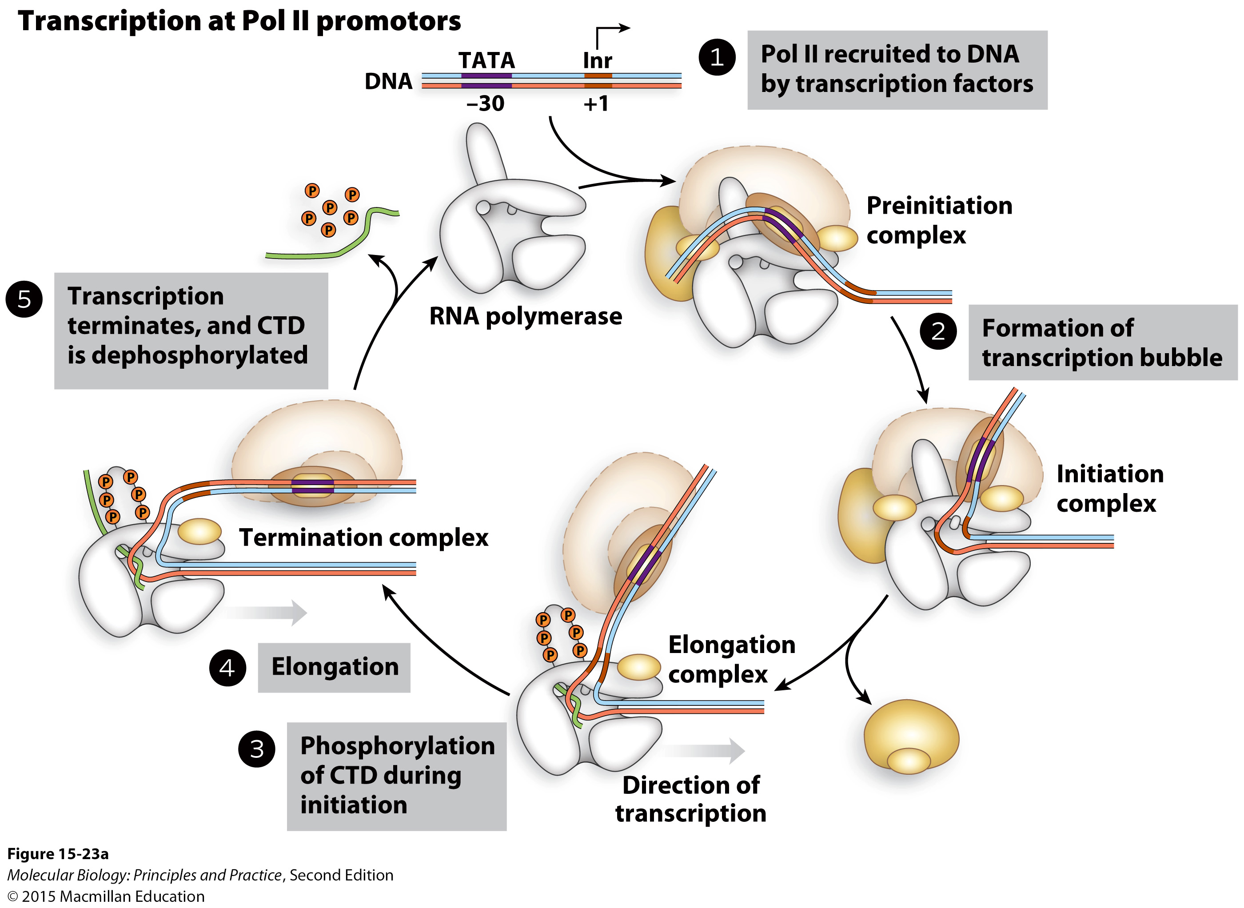
The RNA Pol II C-terminal domain (CTD) is phosphorylated in the transition from initiation to elongation to facilitate interaction with RNA processing proteins

Slide 51
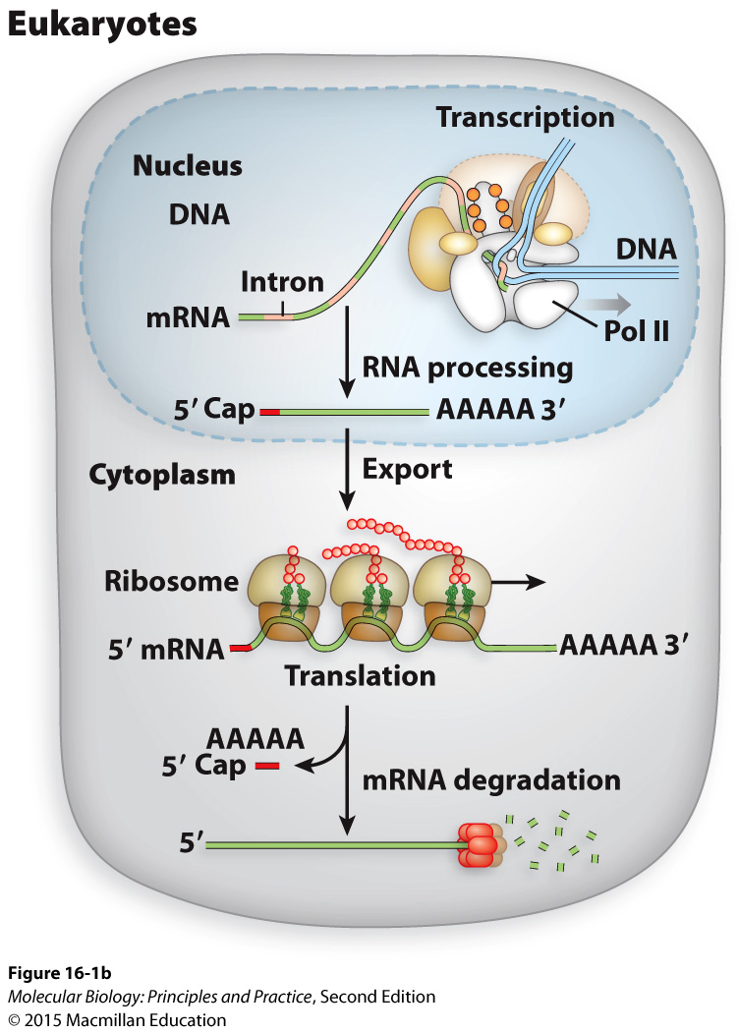
Eukaryotic pre-mRNAs must be processed before nuclear export and translation
Primary transcript ≠ mRNA
Notes:
5’ Cap
Splice out introns
Poly(A) tail

Slide 52
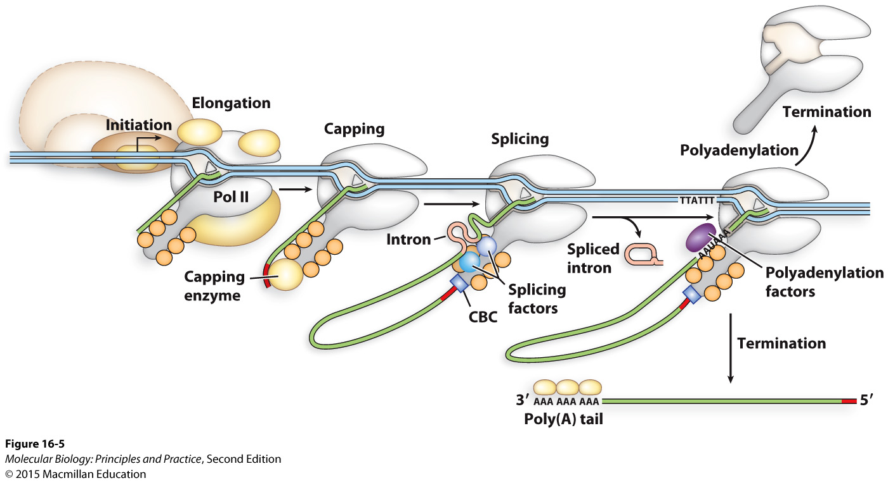
Eukaryotes: mRNA processing is coordinated with transcription

